Slide 1
COS30045 Project Stand Up 1
Topic: Hospitalised Injuries from Road Crashes in Australia
By: Helen AND AKHILA

Slide 2
Background & Motivation
~45,000
3rd
~3×
hospitalisations/year from road crashes nationally
leading cause of injury hospitalisation in Australia
higher rate for First Nations vs non-Indigenous
Why This Matters
Our Solution
Road crash deaths get media attention, but non-fatal injuries create a far larger ongoing burden — long hospital stays, ongoing care, and loss of work. First Nations peoples face disproportionately high hospitalisation rates, particularly in remote areas. Government data exists but sits in complex spreadsheets inaccessible to most people.
We turn raw BITRE hospitalisation data (2011–2021) into an interactive website built with D3.js. Users can: • Explore trends over 11 years • Compare First Nations vs non-Indigenous rates • Filter by age group, road user type, and remoteness • Identify where disparities are largest

Slide 3
Visualisation Purpose
Target Audience:
Policymakers & public health researchers · Road safety organisations · General public & journalists
Q1
Trends Over Time
Q2
Age Group Differences
How have hospitalisation numbers for First Nations peoples changed each year from 2011–2021, and how does this compare to non-Indigenous Australians?
Which age groups have the highest hospitalisations among First Nations peoples — is it young adults (17–25) or other cohorts?
Q3
Location & Remoteness
Q4
Road User Types
Do patterns differ between Major Cities, Regional, and Remote areas for First Nations peoples?
Which road users (car occupants, motorcyclists, pedestrians) are most often hospitalised, and has this changed over 11 years?

Slide 4
Visualisation Design
Chart Types Chosen
Design Principles
Line Chart
Graphical Integrity
Trends 2011–2021. Two lines (First Nations vs non-Indigenous) — gap communicates disparity directly.
Axes start at zero. Each chart notes counts are not population-normalised — NT vs VIC comparisons can otherwise mislead.
Grouped Bar Chart
Accessibility
Age group & road user breakdowns — ordinal categories, not continuous. Direct side-by-side comparison.
Navy/amber palette (colourblind-safe, avoids red/green). Body text ≥14pt. WCAG AA contrast standards met.
Horizontal Bar Chart
Cultural Sensitivity
Remoteness — long labels read better on a horizontal axis.
First Nations data presented respectfully — no deficit framing. Follows AIHW Indigenous data guidelines.
Stacked Bar Chart
Road user share by year — shows both total count and composition without misleading pie slices.
Draft colour palette (colourblind-safe):
Navy / First Nations
Amber / Non-Indigenous
Teal / Accent
Slate / Grid

Slide 5
Project Overview
Topic: Road crash hospitalised injuries in Australia (2011-2021)
Focus: First Nations vs Non-Indigenous disparities
Key question our visualisation will answer:
1. How have trends changed over 11 years?
2. Which age/road user/remoteness groups are highest risk?
3. Where are the largest equity gaps?

Slide 6
Project Setup & Data Identification
Project Design Book – FULL DRAFT finished​
Introduction, background, motivation, purpose​
Data source & governance documented​
2. Data identified & collected​
BITRE/ First-Nations-hospitalised-injuries-2023.xlsx
3. Data dictionary fully reviewed
4. KNIME workflow built​
Data import, cleaning, reshaping, unpivot
5. GitHub Classroom team created & shared​
https://github.com/Sixxx-cake/Data-Visualisation---Project

Slide 7
Data Source
Source: AIHW National Hospital Morbidity Databse
Published by: BITRE (Bureau of Infrastructure, Transport, Regional Development, Communications and the Arts)
File used: First-Nations-hospitalised-injuries-2023.xlsx
Period: 2011-2021 (11 years)
Privacy: Fully de-identified – only group totals, no indivdual records

Slide 8
Data Quality Issues
Limitation | What It Means
"n.p." values | Counts under 5 are hidden → some breakdowns incomplete
Vic/NSW coding changes | 2012 & 2017 breaks in series → cautious on state trends
Counts only | No population-adjusted rates → can't compare group sizes fairly

Slide 9
Ethical Considerations
We follow ethical guidelines for reporting Indigenous health data
Focus on systemic patterns, not individual behaviour
No personal or identifiable information in the dataset

Slide 10
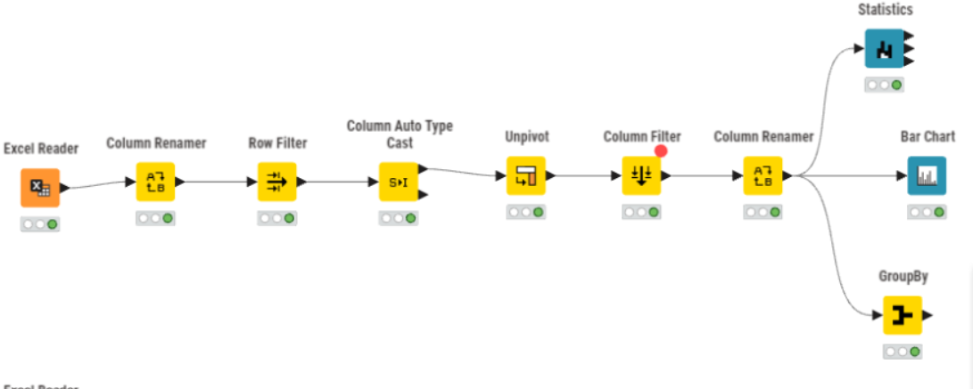
Data Processing – KNIME Workflow

Slide 11
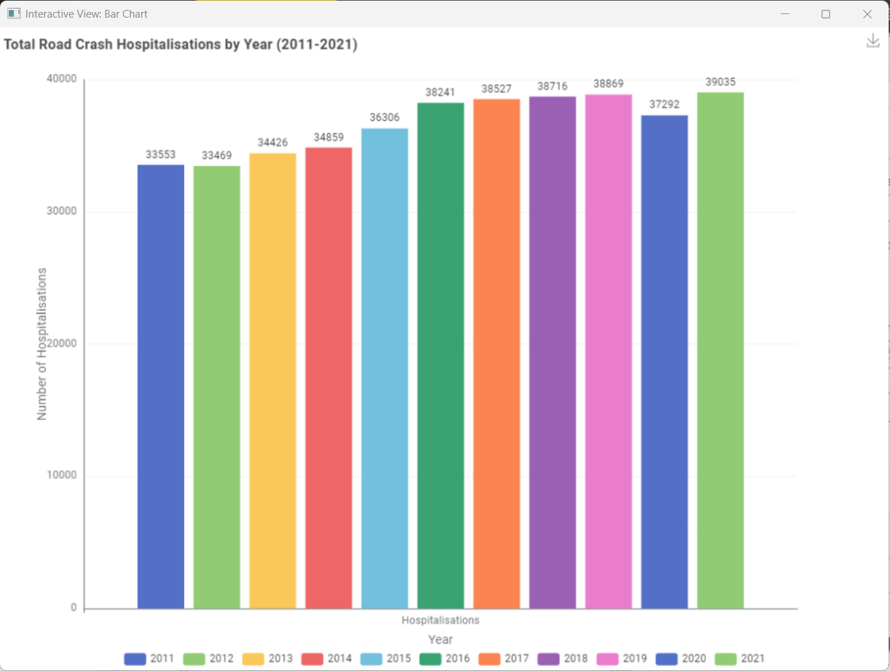
Preliminary EDA – National Trend (All Australians)
A key figure: Total range ~ 33,553 (2011) → 39,035 (2021)
A line of Observation: Slight dip in 2020, possible COVID lockdown effect

Slide 12
Next Steps
Apply the same KNIME workflow to the "First-Nations-hospitalised-injuries-2023.xlsx" dataset (Tables 1-4: annual, road user, age group, remoteness)
Extract the comparison numbers needed for D3.js (First Nations vs Non-Indigenous by each dimension)
Export cleaned data as CSV for D3 development

Slide 13
Work In Progress
Refining KNIME to combine all tables (age, road user, remoteness)
Finalising visualisation design (charts, colours, interactions)
Preparing D3.js setup for interactive web visualisation.

Slide 14
Q & A
Thank you!
Any Questions?

